Slide 1
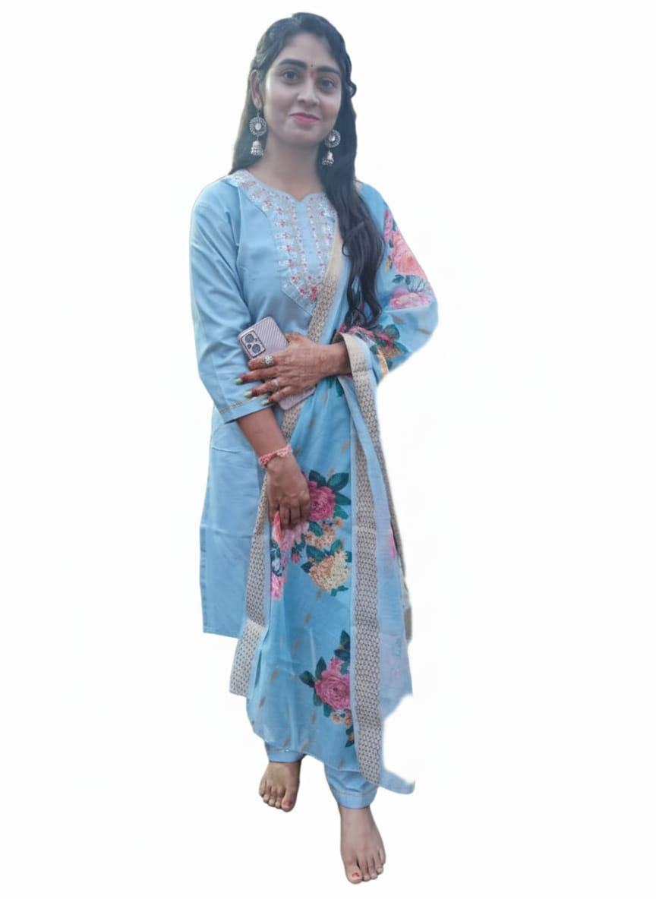
BIO DATA
NAME- neha Jaiswal
BIRTH NAME-SHIvANI JAISWAL
BIRTH-DATE-06.08.2001
BIRTH-PLACE-KHARGONe
BIRTH-TIME-5.44PM
HEIGHT-5.4
EDUCATION-BMLT. COMPLETED
OCCUPATION-PROFESSOR IN PARAMEDICAL COLLAGE KHARGONE

Slide 2
FAMILY BACKGROUND
FATHER’S NAME-MR.BHUPENDRA JAISWAL
Occupation-business
MOTHER’S NAME- MRs.ARCHANA JAISWAL
Occupation-housewife
Brother’name-kartik Jaiswal(b.tech pursuing in medicaps university indore)
mamaji-dedgaon & bhaNgAON (BORAWA)
Contact and address
Address-kartik general store premnagar sanawad road Khargone m.p.
Contact no.-9977571990,9131947248

